Slide 1

Assignment 2
Personality traits
BBA 1st Sem (2022-2023)
Submitted By- Shankh Bansal
Submitted To- DR. Gaurav Bagra

Slide 2
What type of personality do I have?
Positive Negative
Committed Anxious
Confident Over thinker
Motivated Moody
Supportive
Optimistic
Leadership

Slide 3
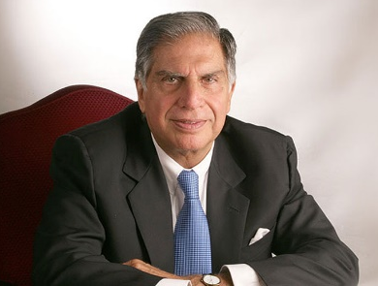

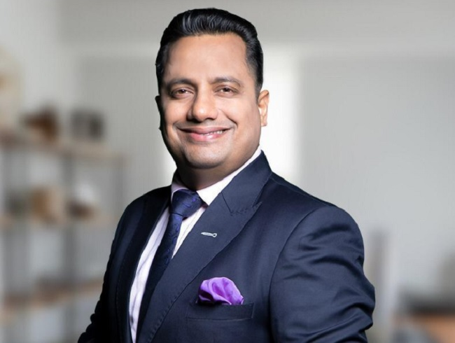
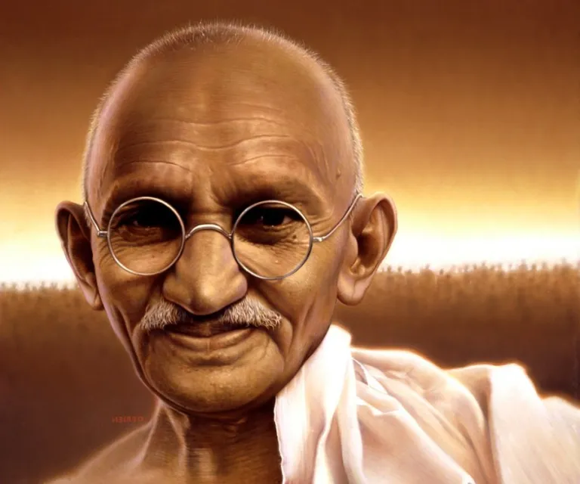
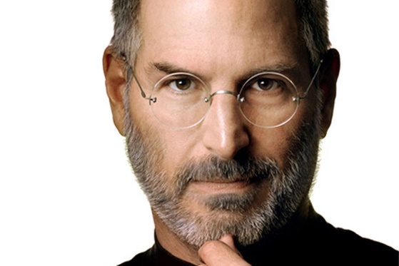
Personality mapping
Confident
Motivated
Committed
Leadership
Optimistic
Rattan Tata
Sandeep Maheshwari
Vivek Bindra
Mahatma Gandhi
Steve Jobs

Slide 4
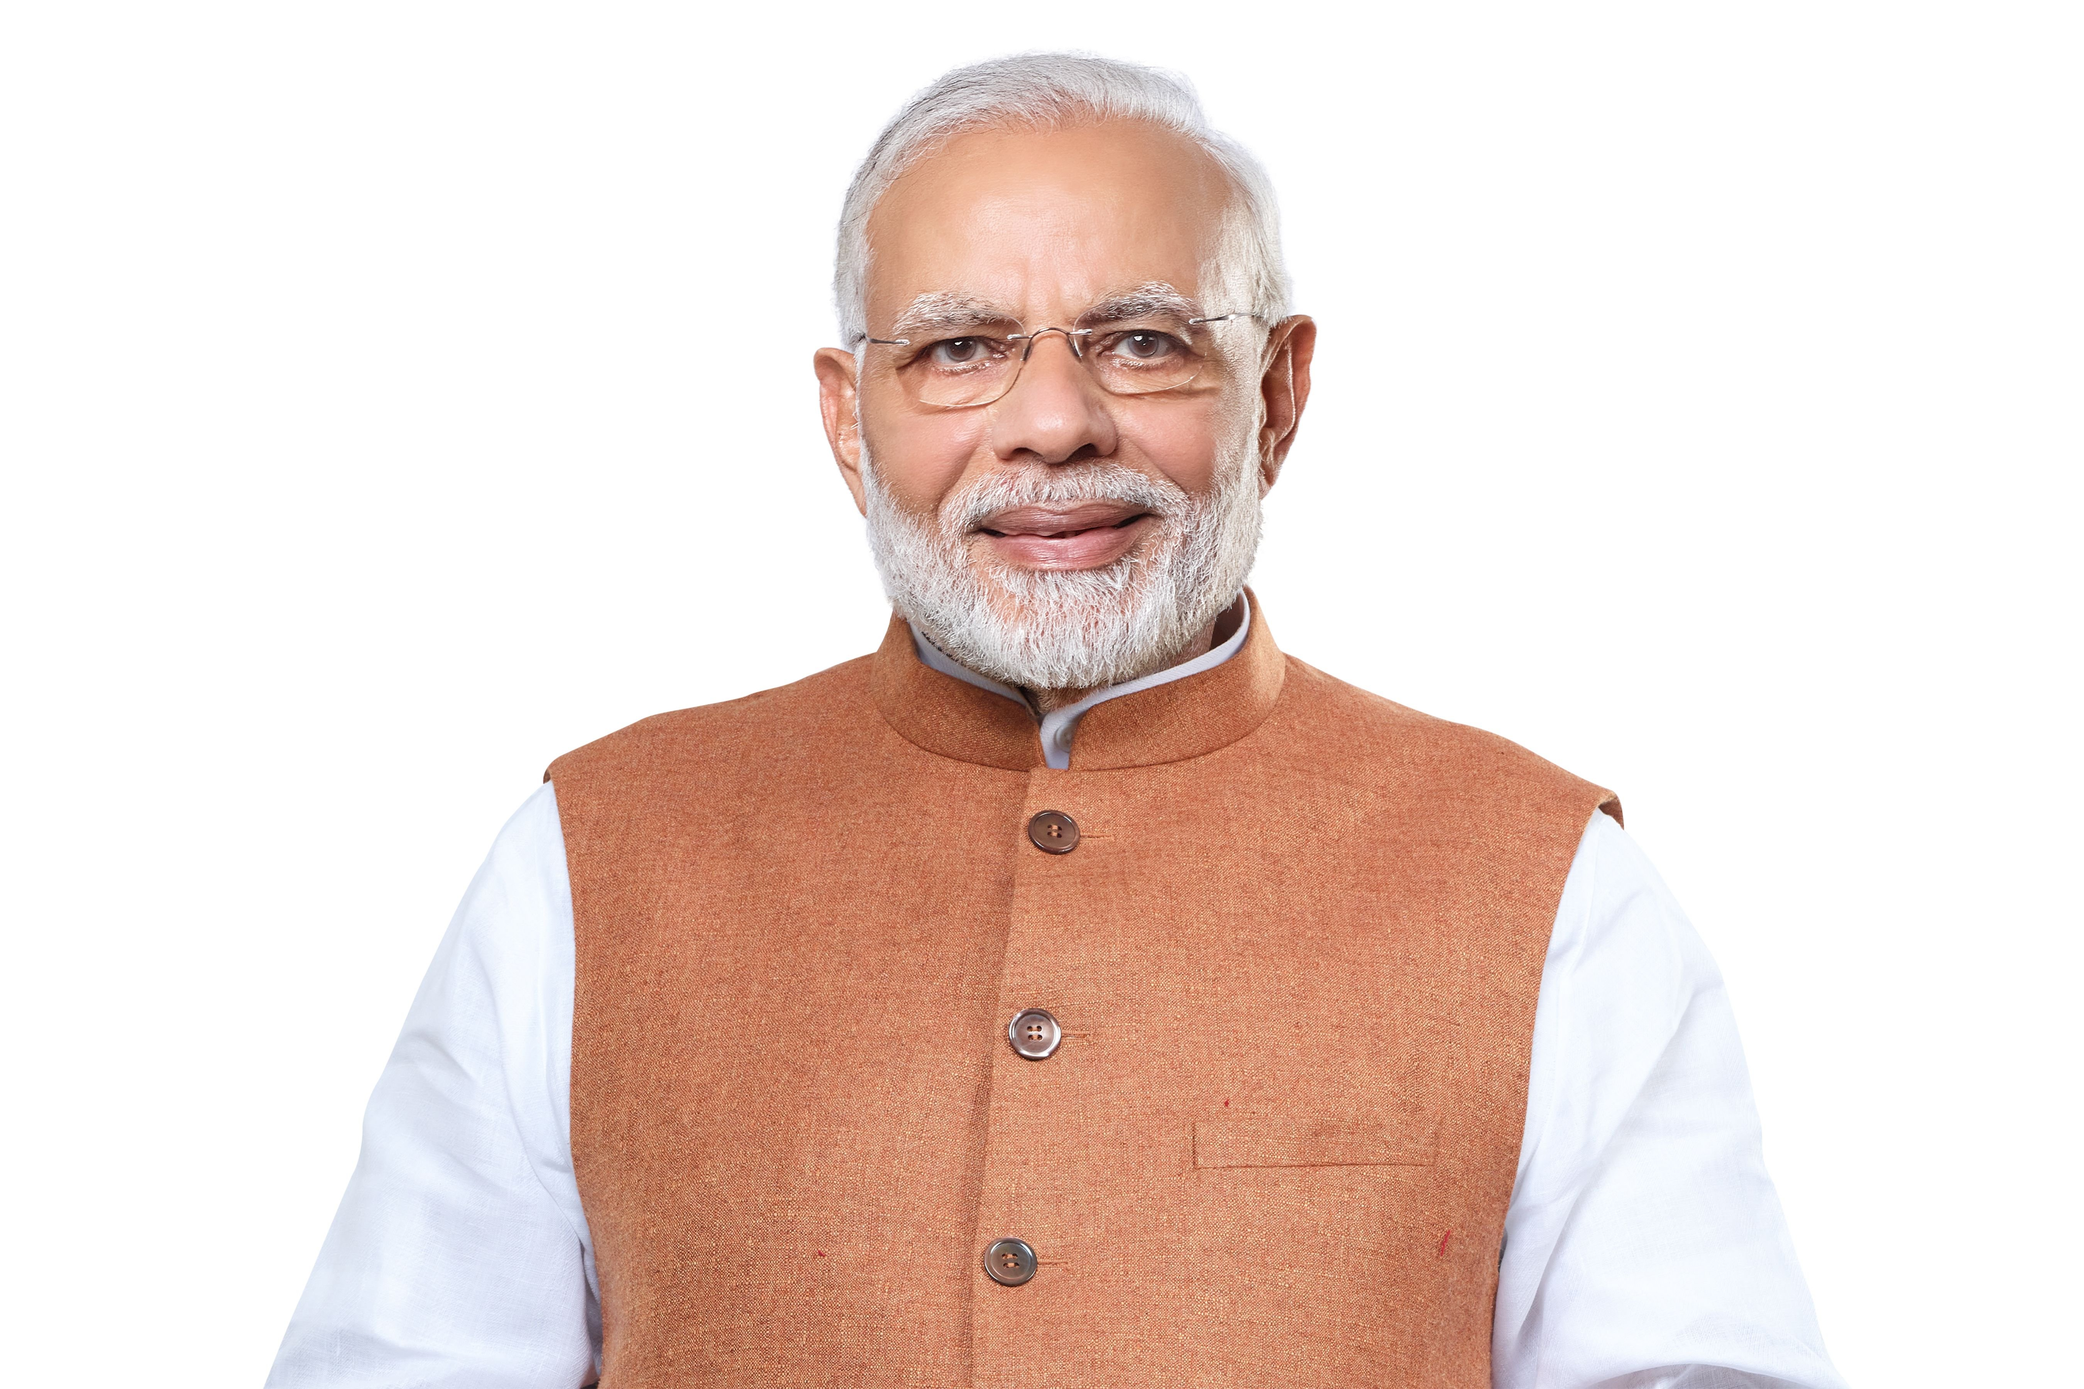
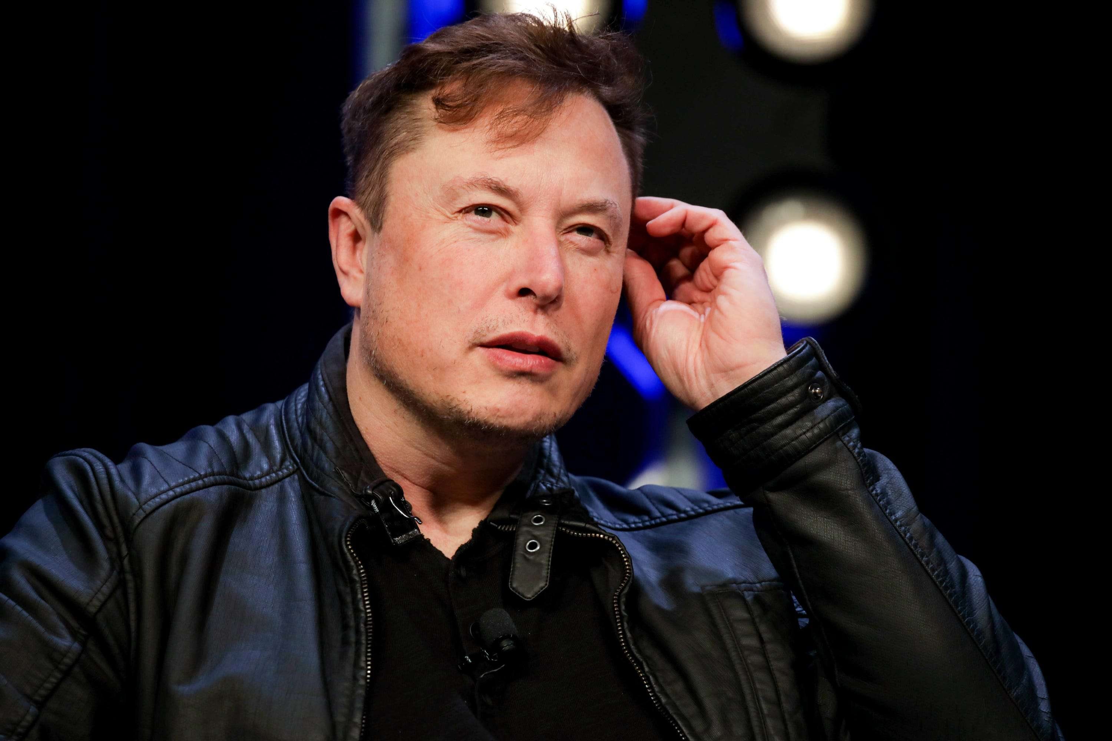
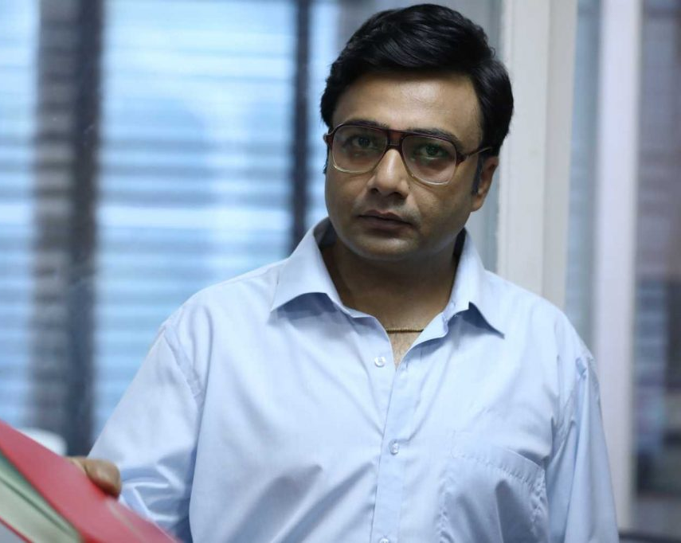
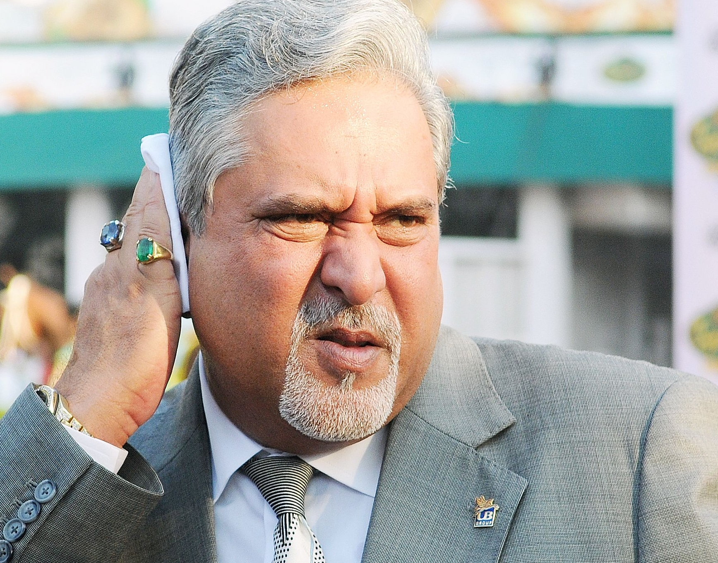
Supportive
Anxious
Over thinker
Moody
Narendra Modi
Elon Musk
Ashwin Mehta
Vijay Mallya

Slide 5
Learning outcomes
Arose different personalities
Improves personality
Improves critical thinking
Enhances confidence

